Slide 1
Weekly Update #16
Gijs Admiraal

Slide 2
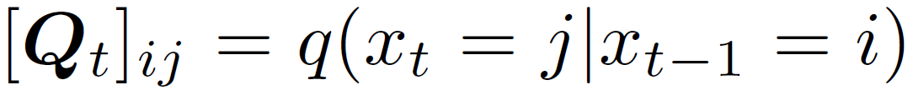
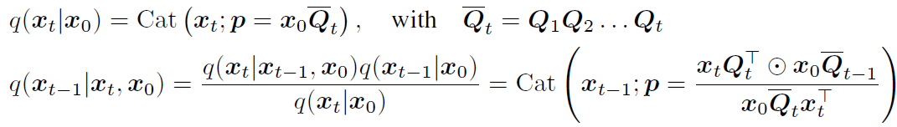
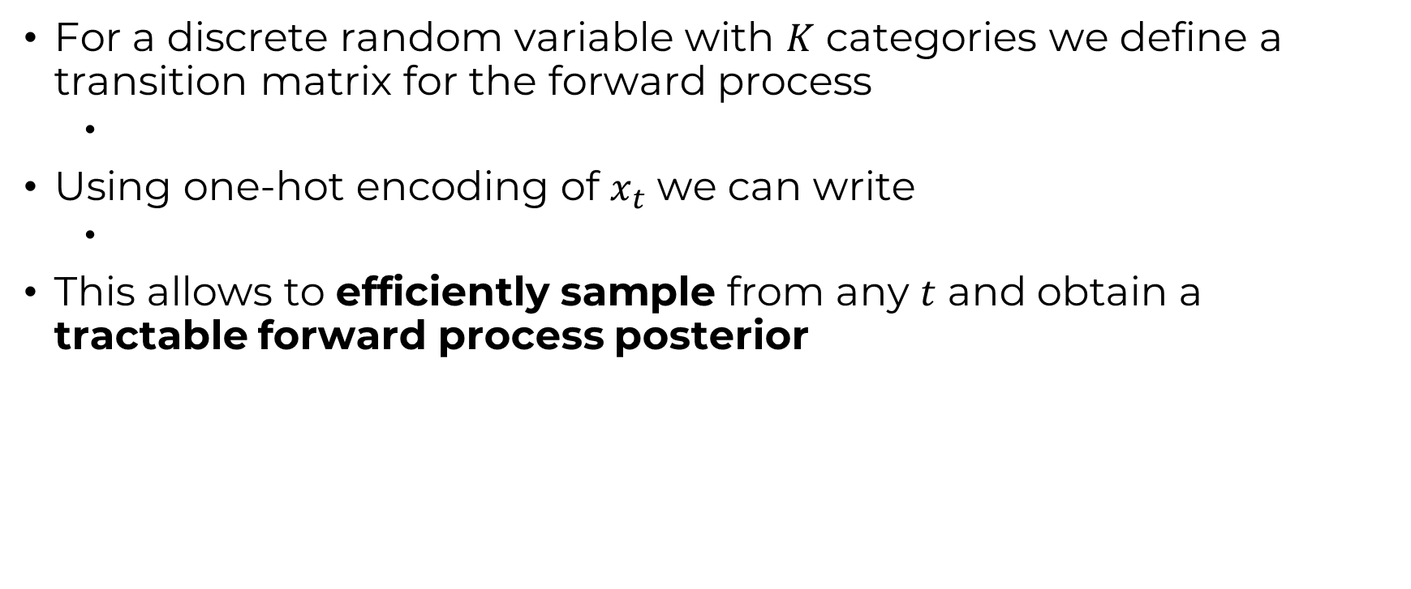
Discrete DDPM (D3PM)
For a discrete random variable with $K$ categories we define a transition matrix for the forward process
Using one-hot encoding of $x_{t}$ we can write
This allows to efficiently sample from any $t$ and obtain a tractable forward process posterior

Slide 3

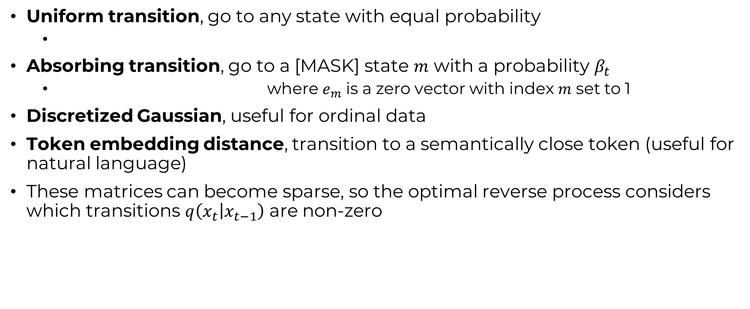
Transition matrices
Uniform transition, go to any state with equal probability
Absorbing transition, go to a [MASK] state $m$ with a probability $β_{t}$
where $e_{m}$ is a zero vector with index $m$ set to 1
Discretized Gaussian, useful for ordinal data
Token embedding distance, transition to a semantically close token (useful for natural language)
These matrices can become sparse, so the optimal reverse process considers which transitions $q\left(x_{t} | x_{t−1}\right)$ are non-zero

Slide 4
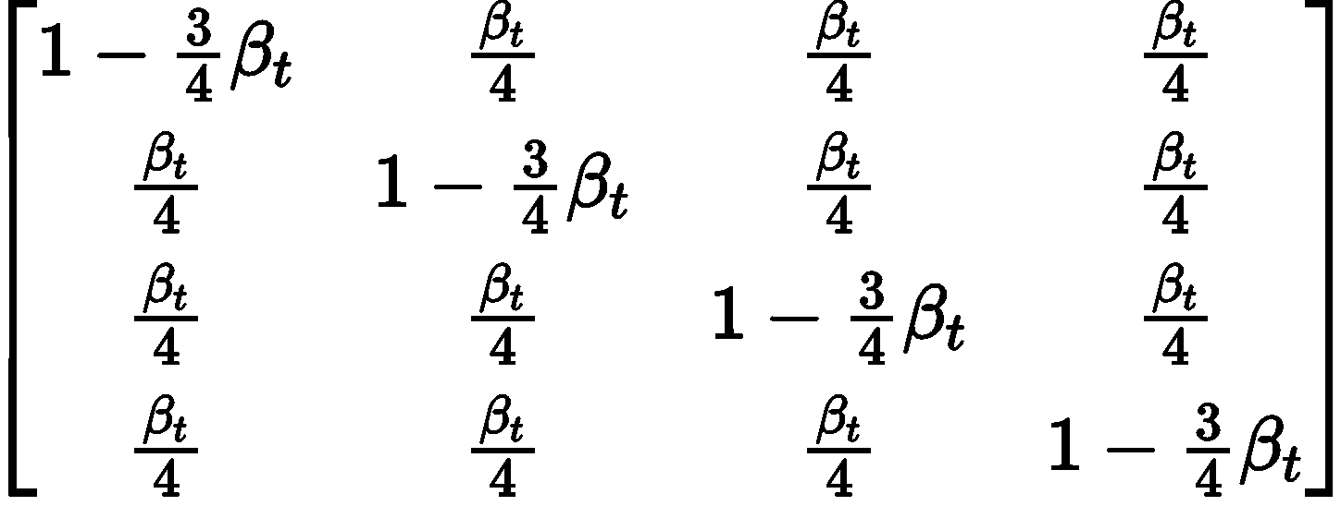
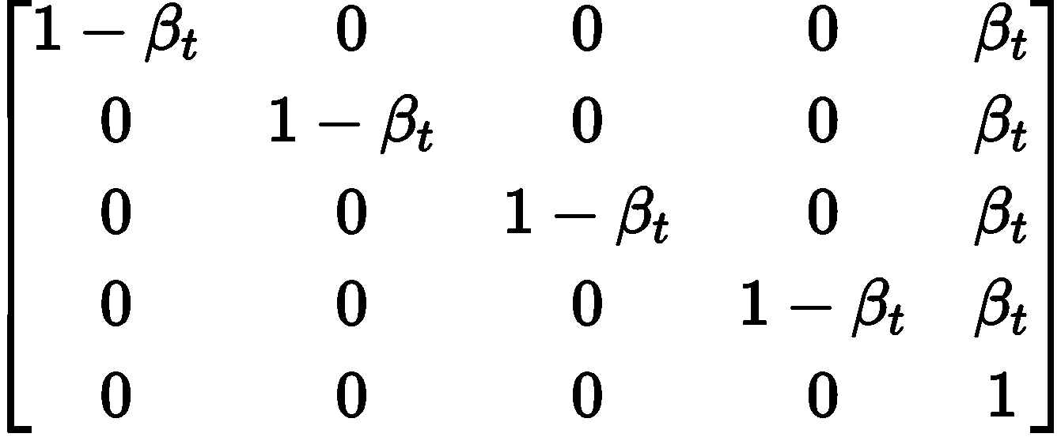
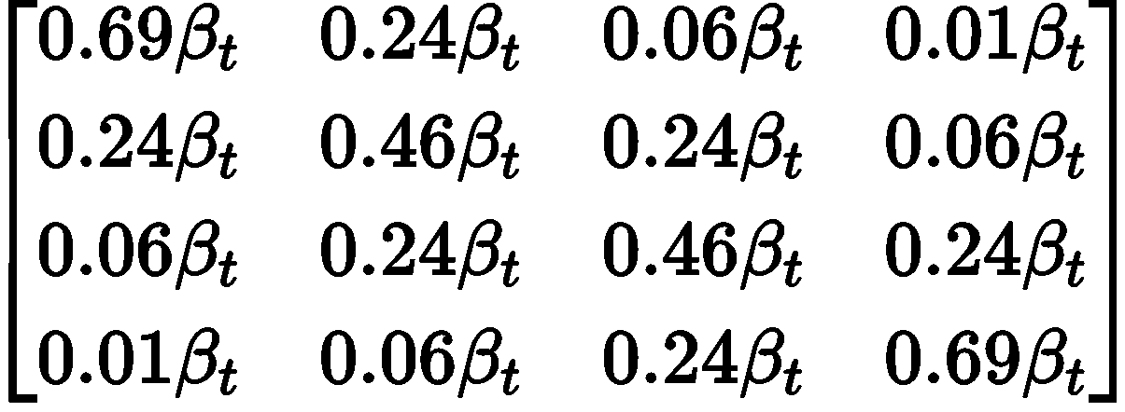
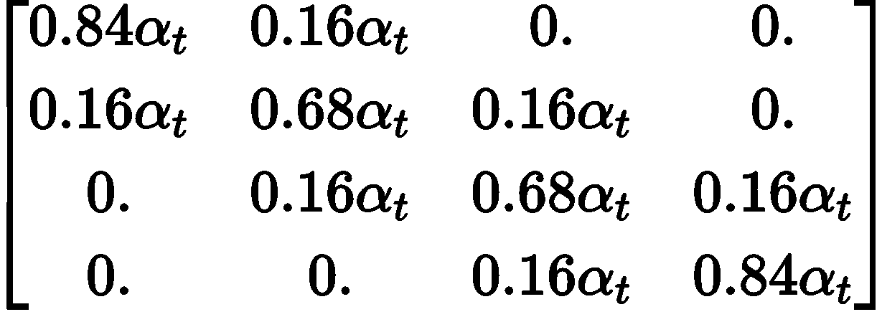
Transition Matrix example
Uniform
Absorbing state
Discrete Gaussian
Token embedding
In reality we want a matrix that maintains a uniform stationary distribution

Slide 5
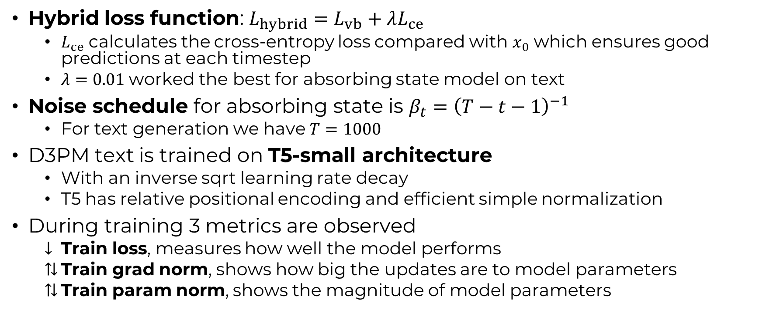
D3PM
Hybrid loss function: $L_{hybrid}=L_{vb}+λL_{ce}$
$L_{ce}$ calculates the cross-entropy loss compared with $x_{0}$ which ensures good predictions at each timestep
$λ=0.01$worked the best for absorbing state model on text
Noise schedule for absorbing state is $β_{t}={\left(T−t−1\right)}^{−1}$
For text generation we have $T=1000$
D3PM text is trained on T5-small architecture
With an inverse sqrt learning rate decay
T5 has relative positional encoding and efficient simple normalization
During training 3 metrics are observed
Train loss, measures how well the model performs
Train grad norm, shows how big the updates are to model parameters
Train param norm, shows the magnitude of model parameters

Slide 6
This week?
Finalized dataset and analysis
Read up on SEFLIES
Run D3PM on aa sequences
DDiT_Llama with uniform transition
Started implementing T5

Slide 7
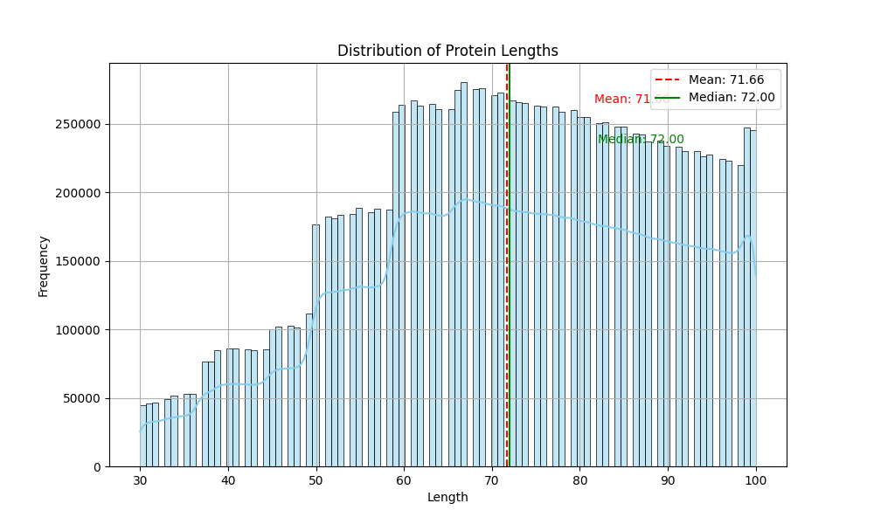
UniRef50
Created a training/validation/test split (0.8/0.1/0.1)
AA sequence
Vocabulary: 20
Lengths: 30-72-100
Atom sequence
Vocabulary: 21
Lengths: 402-967-1343
F-group sequence
Vocabulary: 15
Lengths: 47-115-160

Slide 8
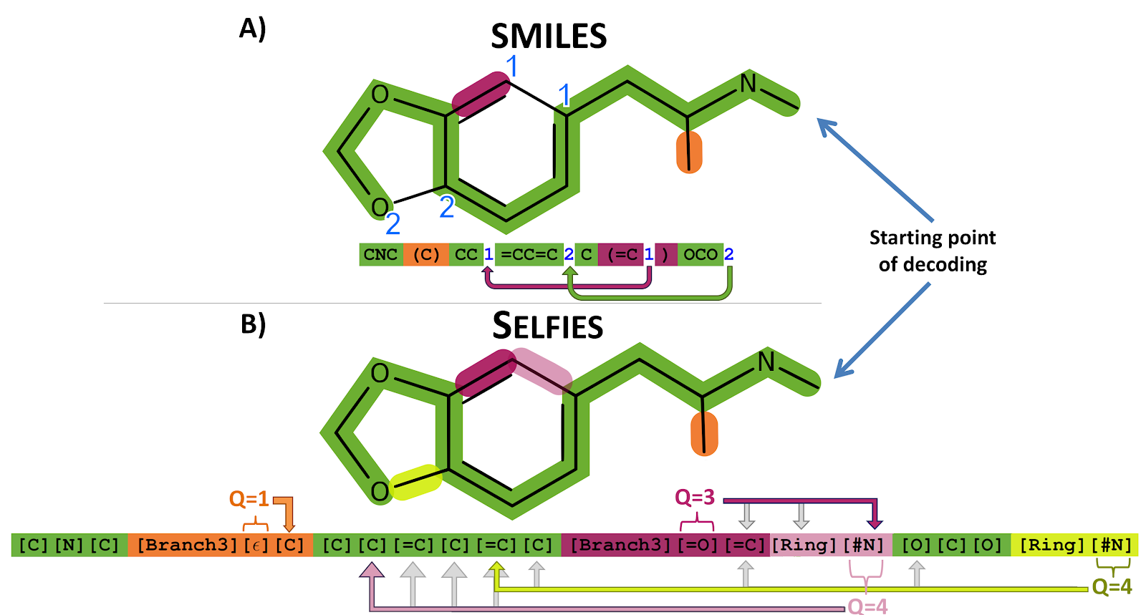
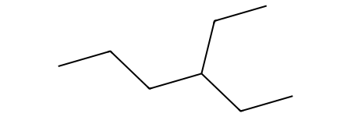


SELFIES
SELFIES was developed specifically for generative tasks
Designed as a formal grammar that is 100% robust
Examples
[C][C][C][C][Branch1][Ring1][C][C][C][C]
[C][=C][C][=C][C][=C][Ring1][=Branch1]
Limitations
Crystal structures and stochasticity
Generated molecule not desired
Use RDKit and SELFIES packages

Slide 9
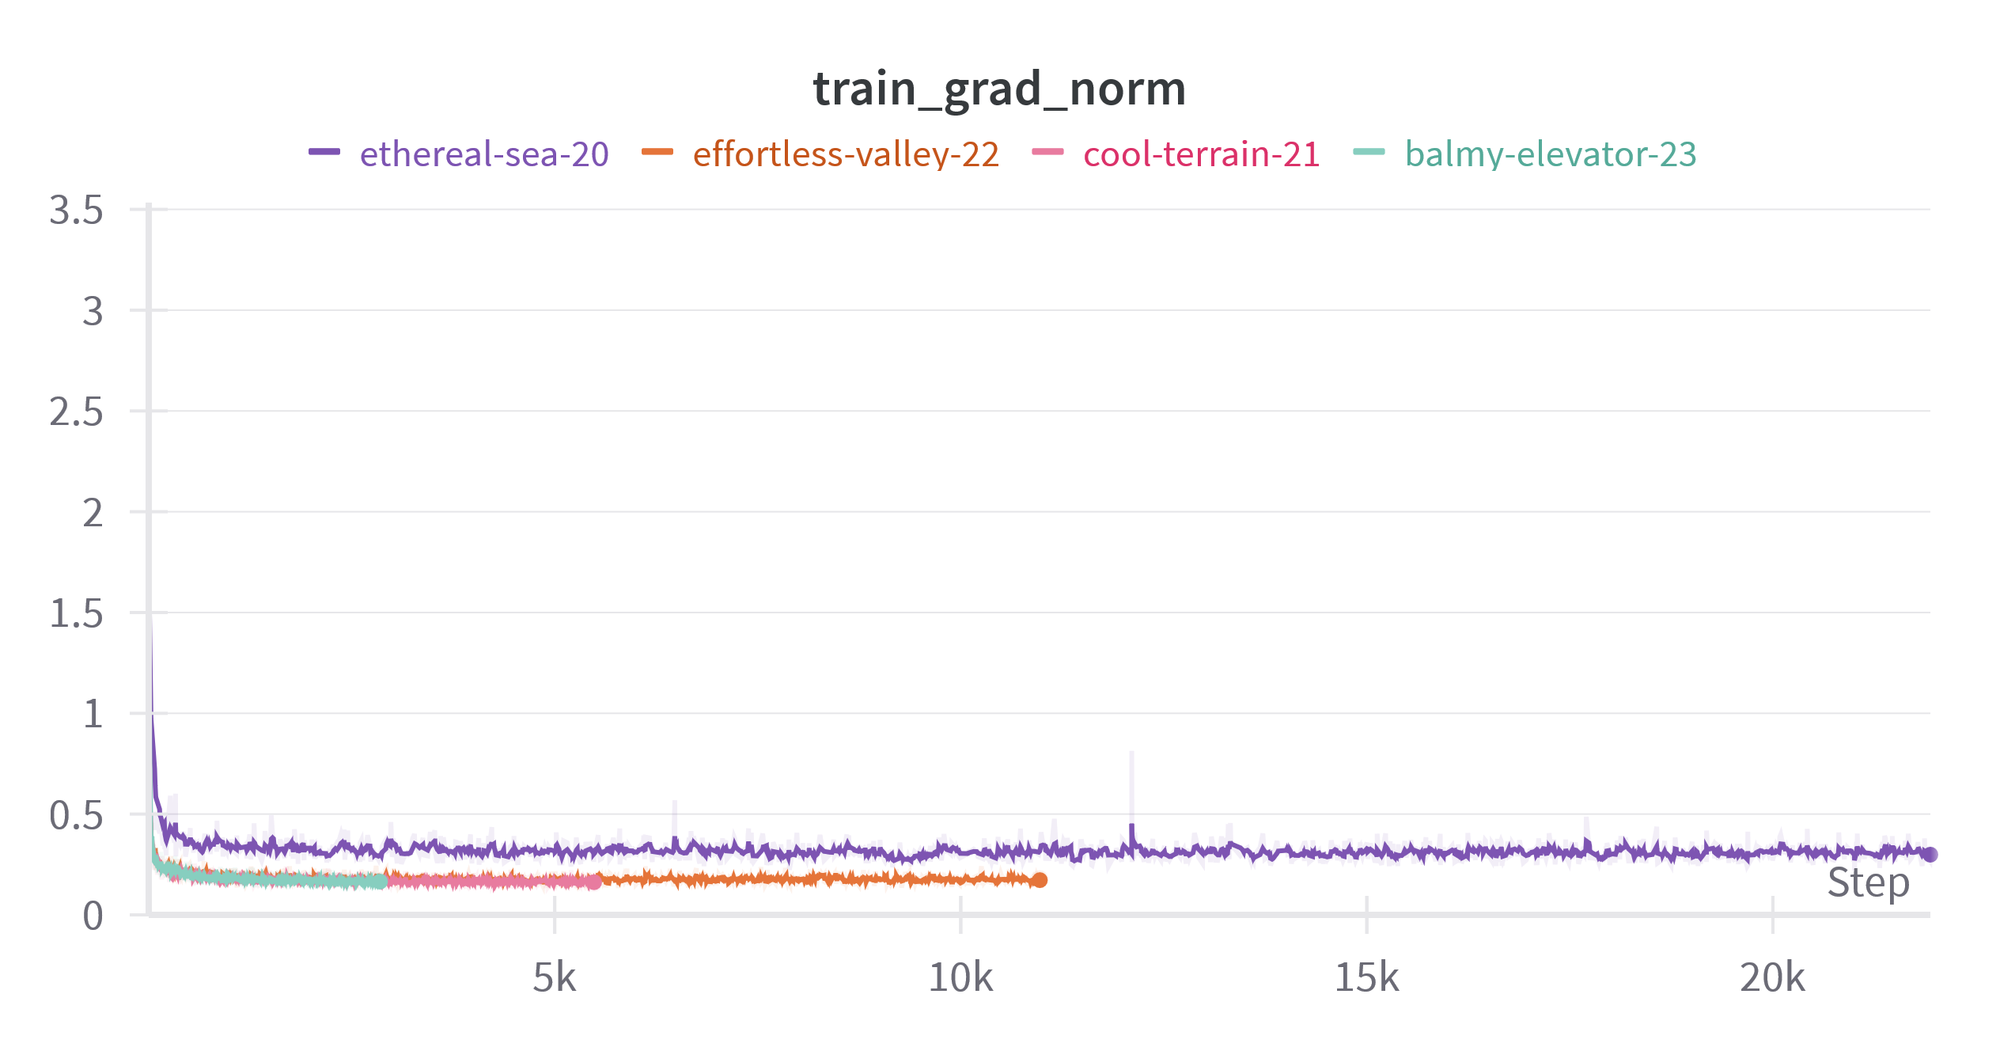
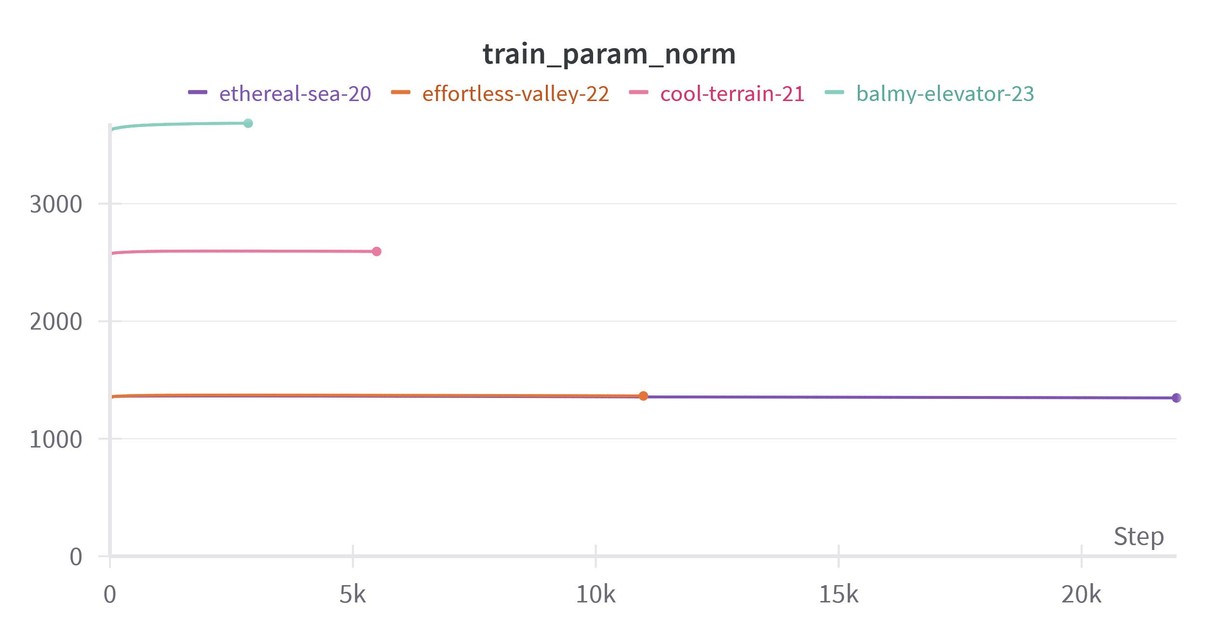
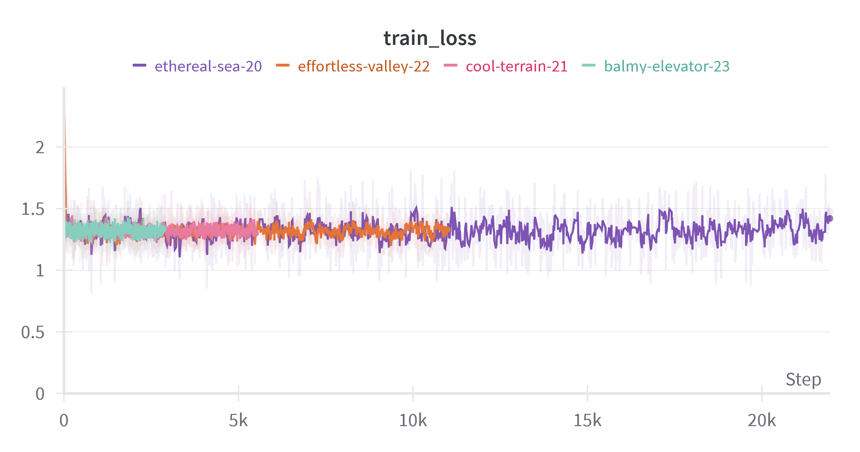
Different setups
Ethereal-sea
Batch size = [32]
Embedding dimension = [384]
# Layers and heads = [6]
Epochs = [5]
Effortless-valley
Batch size = [128]
Embedding dimension = [384]
# Layers and heads = [6]
Epochs = [10]
Cool-terrain
Batch size = [128]
Embedding dimension = [384]
# Layers and heads = [12]
Epochs = [5]
Balmy-elevator
Batch size = [128]
Embedding dimension = [768]
# Layers and heads = [12]
Epochs = [5] (only did 2.6 epochs)

Slide 10
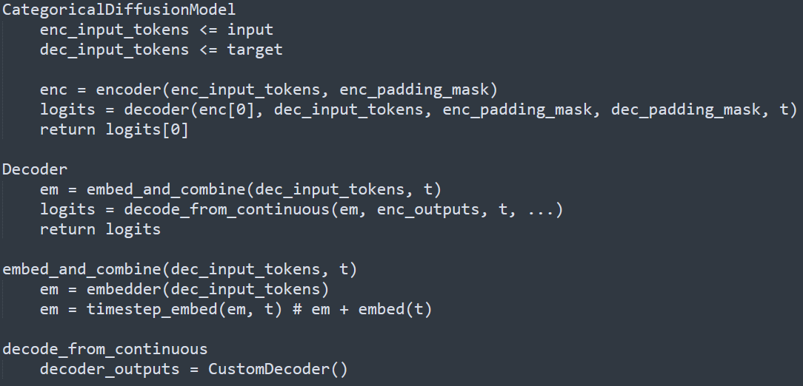
T5 – as used in D3PM
embed_and_combine is easily copied
We don’t have targets – does that matter?
padding_mask is something to look into
How to do the CustomDecoder
Use T5 decoder but how to integrate t

Slide 11
Next week?

Slide 12
Notes

